Slide 1






AI Resume & Career Companion
An End-to-End GenAI System for Intelligent Resume Parsing, Job Matching, Personalized Career Guidance, and Recruiter Candidate Ranking.

Slide 2








Team Division & System Architecture
Frontend / UI
Resume Analyzer
Job & Skill Matcher
Career Assistant
Recruiter & Sync
Member 1
Member 2
Member 3
Member 4
Member 5
•
Streamlit App Framework
•
PDF / DOCX Parsing
•
JD Keyword Match
•
Interactive AI Q&A
•
Batch Resume Scoring
•
Sidebar Navigation
•
Entity Extraction
•
Skill Gap Matrix
•
Learning Roadmaps
•
Candidate Leaderboard
•
Results Dashboard
•
Completeness Check
•
Match Percentage
•
Project Suggestions
•
DB Architecture
•
Score Visualizations
•
Score Calculation
•
Skill Recommendations
•
Resume Polishing
•
System Integration

Slide 3
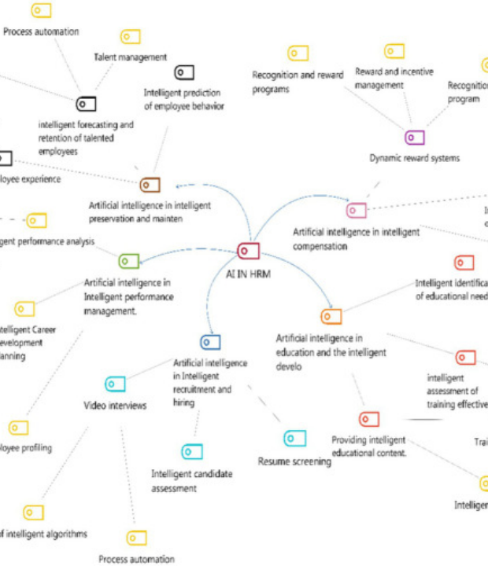





Core Parsing & Skill Matching
Structured Entity Extraction
Converts PDF/DOCX into clean JSON containing Name, Education, Skills, Projects, and Certifications with instant completeness scoring.
Job Description vs Resume Comparison
Calculates overall match percentage and maps matching skills against missing critical keywords for targeted applications.
82/100
78%
4 Missing
RESUME SCORE
JD MATCH RATE
SKILL GAP IDENTIFIED

Slide 4


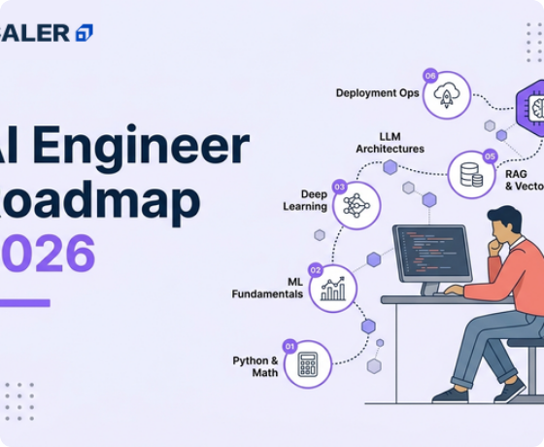


AI Career Assistant & Guidance
Conversational Guidance
Job seekers can ask questions like "What projects should I build?" or "How do I become an ML Engineer?" and receive instant advice.
Dynamic Learning Roadmaps
Generates step-by-step technical roadmaps tailored to target roles (e.g., PyTorch → Docker → AWS → MLOps).
Resume Actionability
Suggests quantifiable bullet points, impactful keywords, and tailored project ideas to bridge skill gaps.

Slide 5


Recruiter Hub & Candidate Ranking
Batch Multi-Resume Processing
Unified Module Integration
Recruiters upload a single Job Description and multiple candidate resumes to calculate instant fit scores.
Member 5 connects resume_analyzer.py, job_matcher.py, and career_assistant.py into the Streamlit UI core.
Candidate Name | Overall Match | Match Progress | Key Missing Skills | Status
1 Rahul Sharma | 92% ⭐ |  | Kubernetes | Top Match
2 Priya Patel | 87% |  | AWS MLOps | Shortlisted
3 Amit Kumar | 81% |  | Docker, System Design | Under Review
4 Neha Singh | 74% |  | PyTorch, AWS, Docker | Under Review

Slide 6


Image Sources
https://cdn.ncbi.nlm.nih.gov/pmc/blobs/6276/12920534/b5f1c8c1747d/frai-09-1718244-g001.jpg
Source: pmc.ncbi.nlm.nih.gov
https://scaler-blog-prod-wp-content.s3.ap-south-1.amazonaws.com/wp-content/uploads/2025/11/28152936/ai-engineer-roadmap-surprise-1785232675.webp
Source: www.scaler.com

